Slide 1
Cs-170 final project
By: Barritt ross

Slide 2
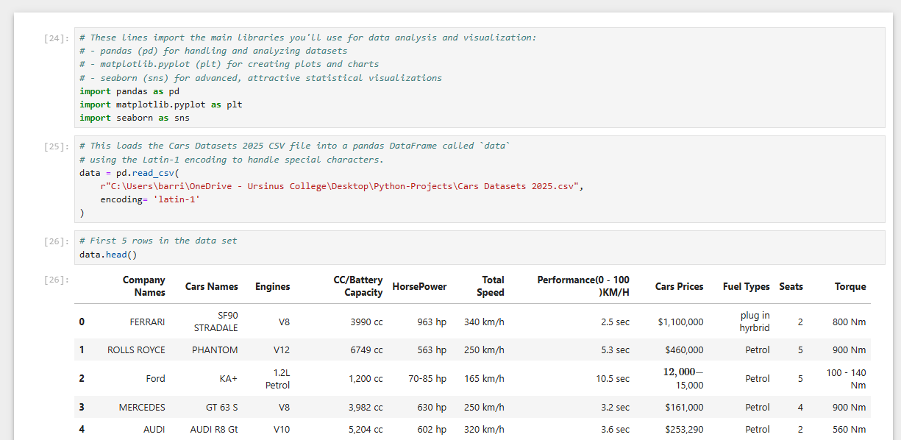
Loading data and libraries

Slide 3
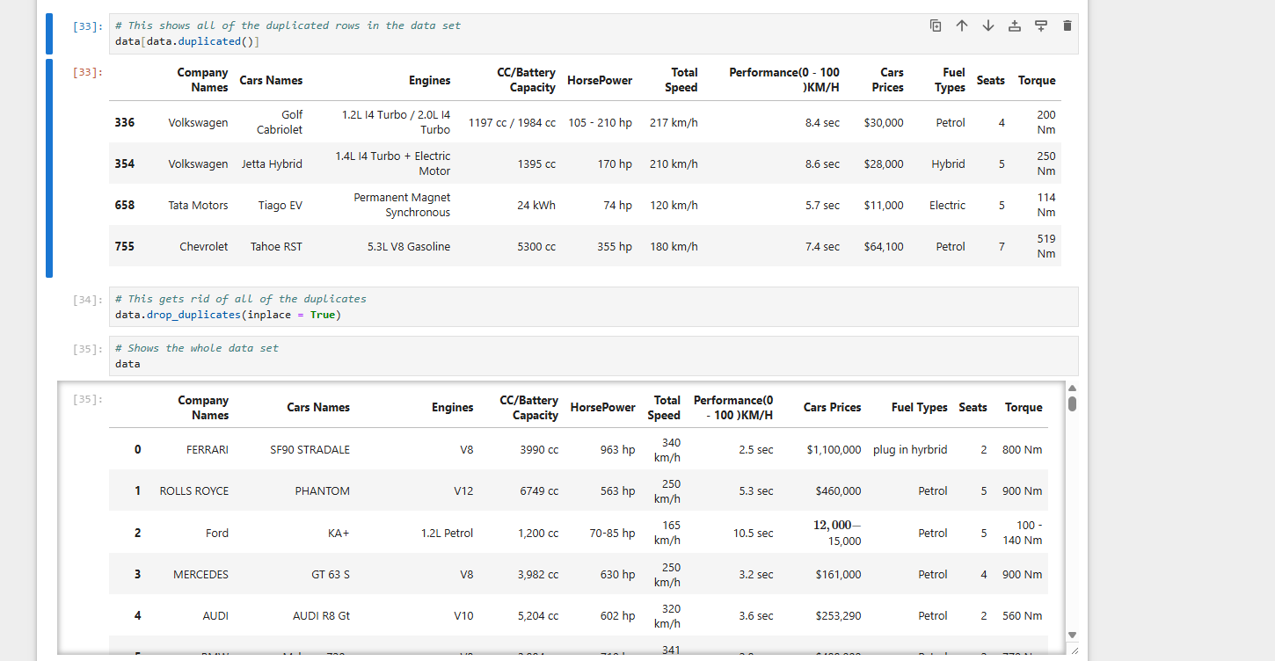
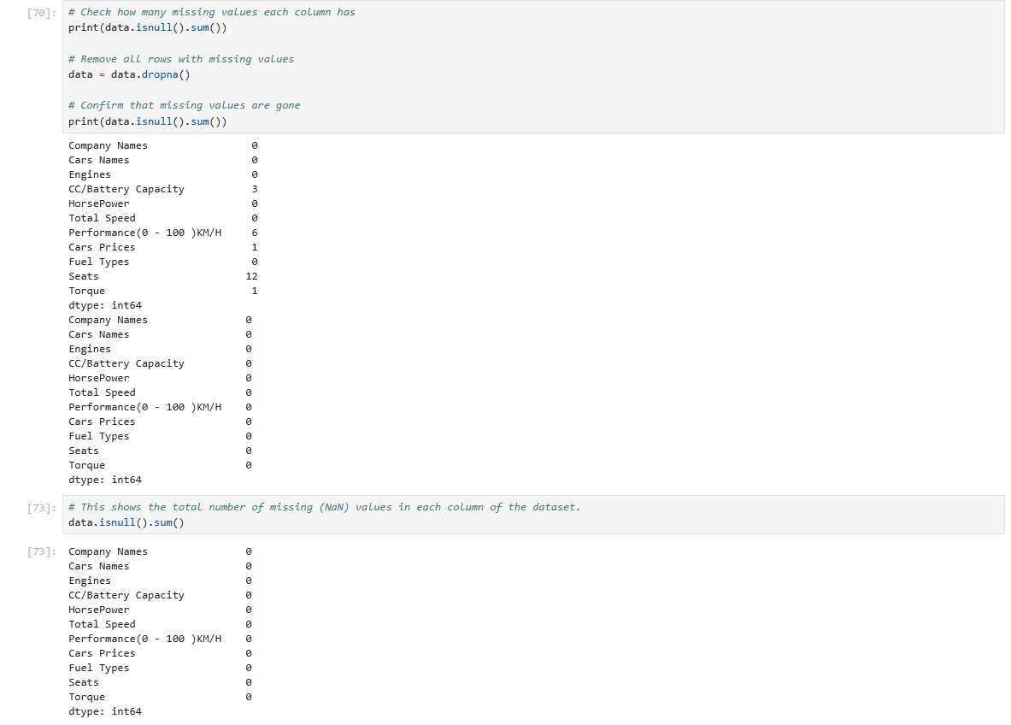

Cleaning and prepping data

Slide 4
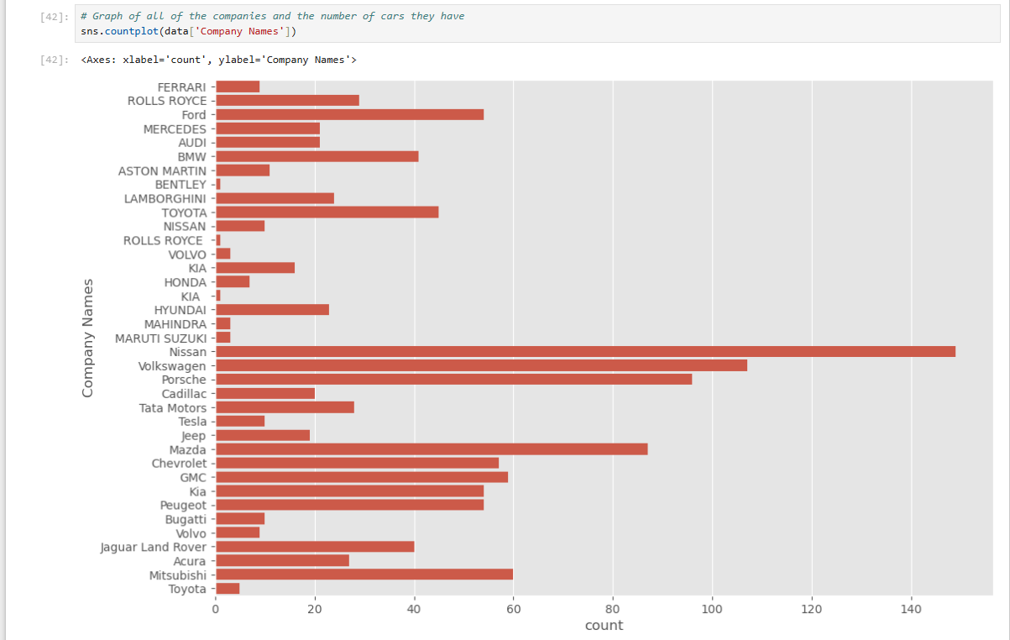
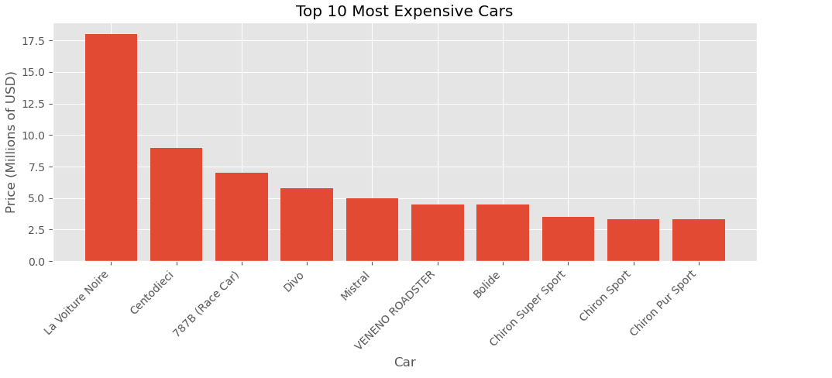
Bar charts

Slide 5
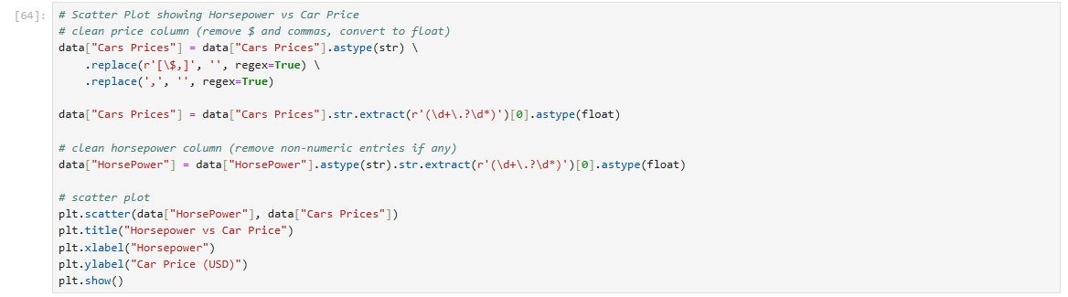
New code
I used multiple steps to clean my data, which removed $, extra commas, extracting numbers, and converting to float
str.extract and replace(regex=True) pulls the numeric values out of the messy text
The code manually converts columns to string cleaned string float

Slide 6
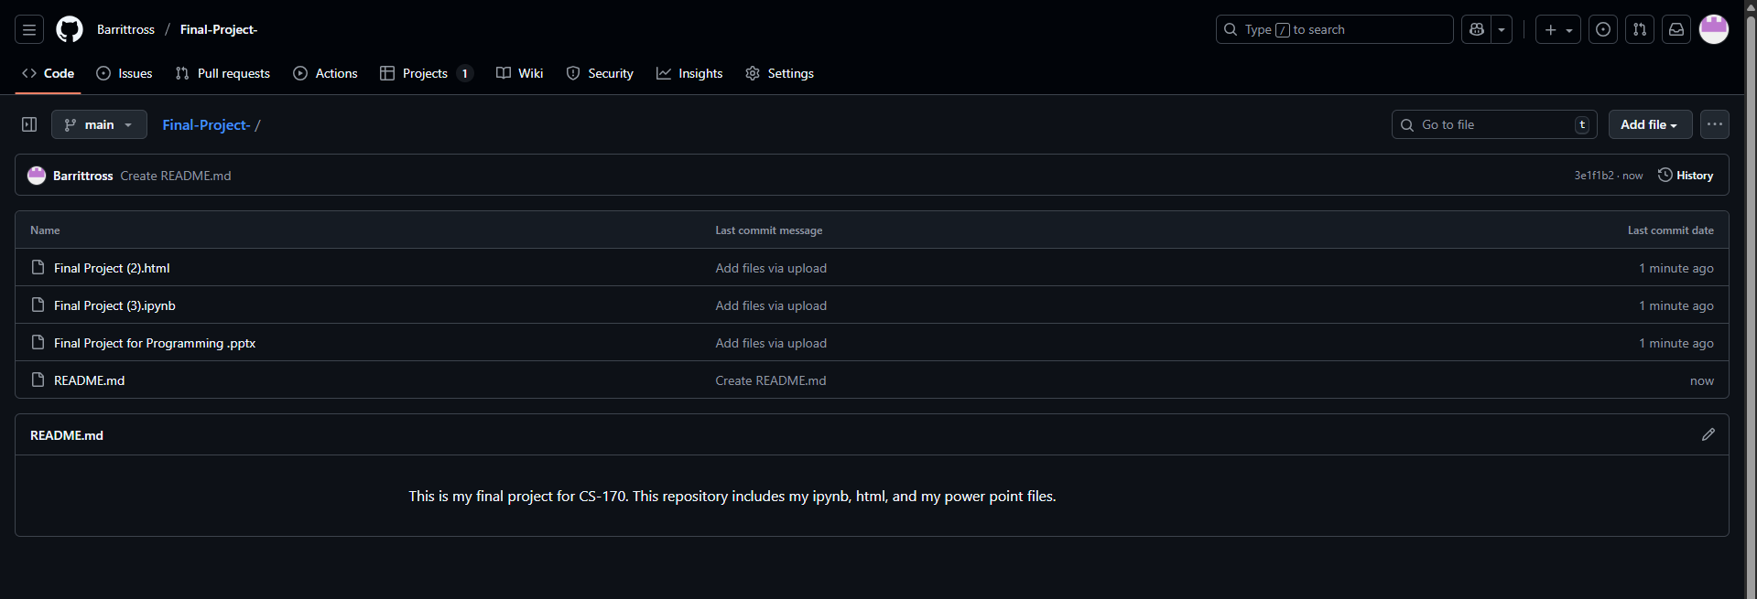
Git-hub upload
https://github.com/Barrittross/Final-Project-

